Slide 1

Binary Classification Model Optimization
By Jackson Swalley

Slide 2
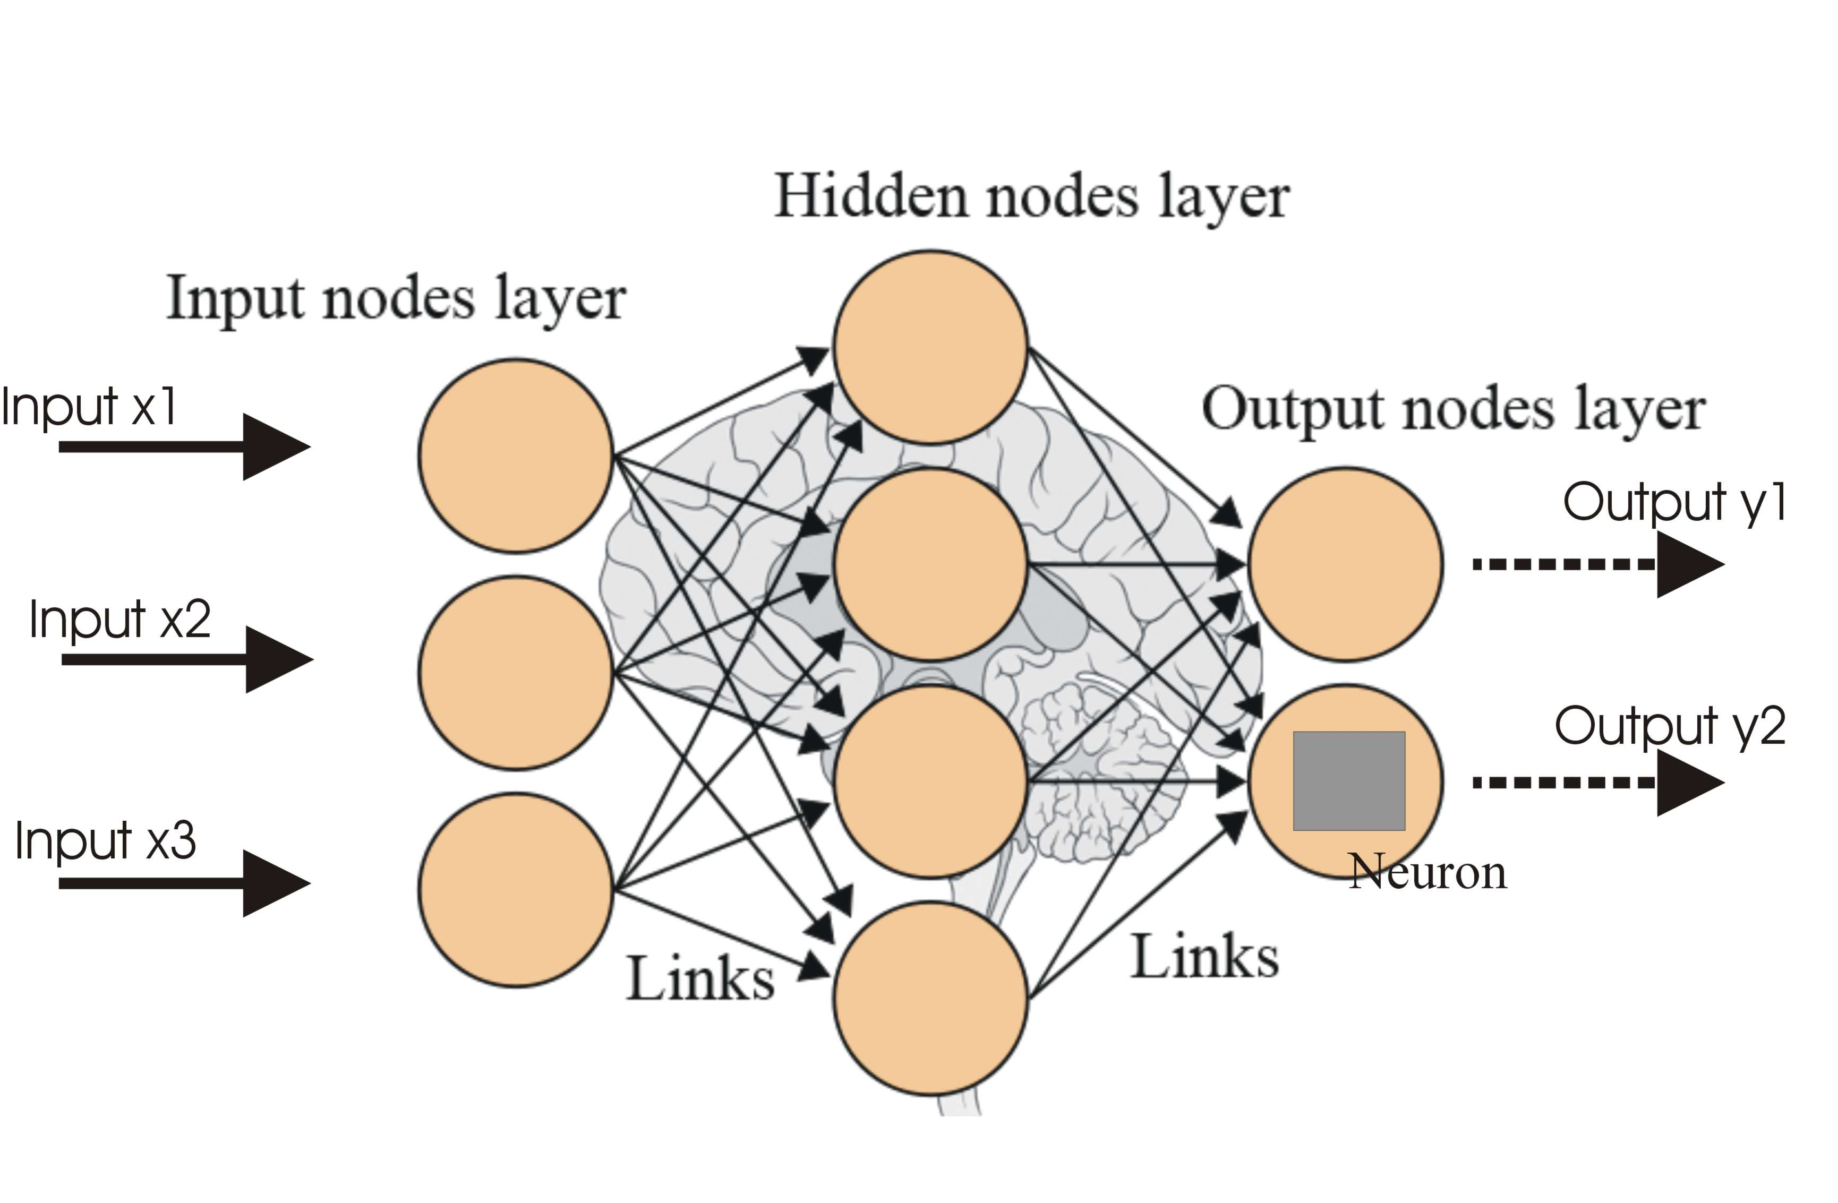
Previous Work
Classification of subjects as diabetic or not
Neural networks using binary classification
Identifies data as true or false for a condition
Activation Functions
Sigmoid – values between (0,1) with sigmoid operation
Relu - values between (0,1) linearly
tanh – values between (-1,1) with tanh operation
Loss Functions
Binary cross entropy
Hinge

Slide 3
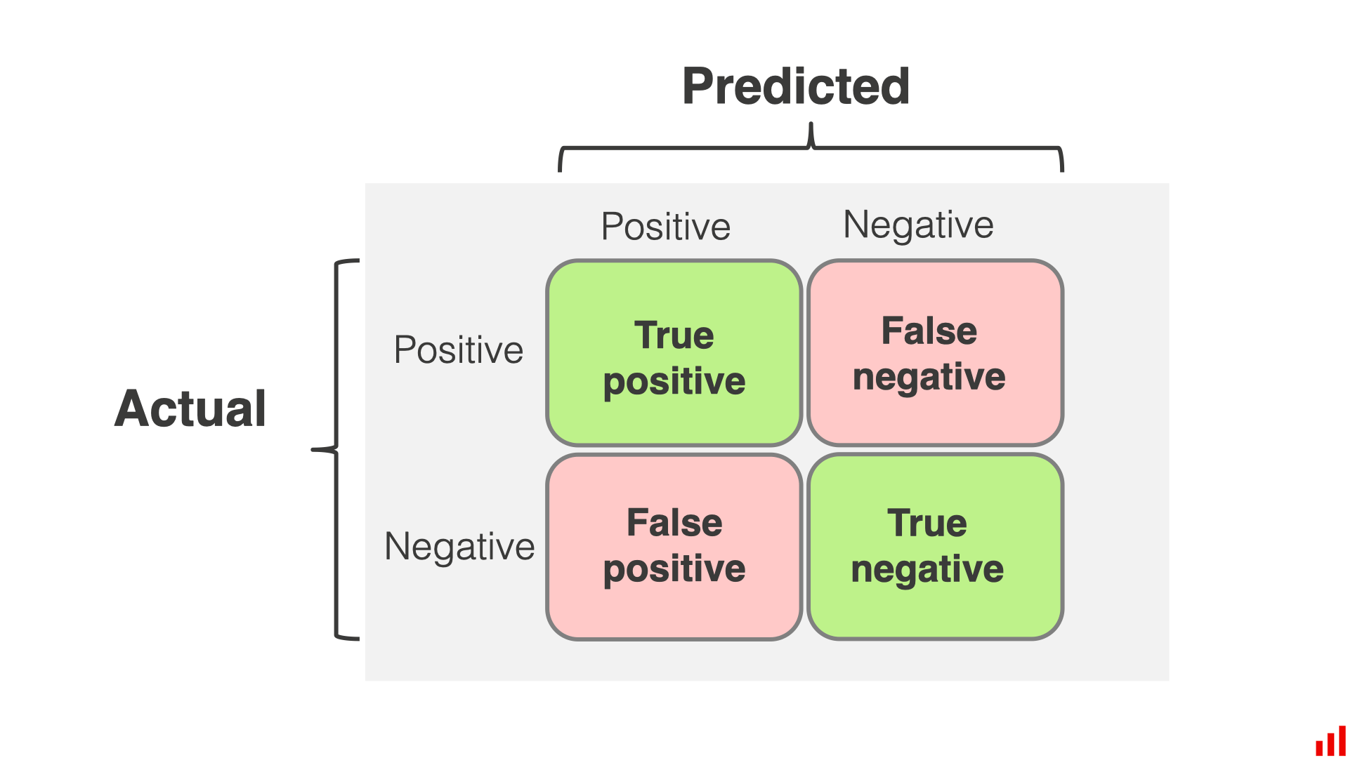
Objectives
Binary classification of individuals with diabetes
Identify model parameters within a set to achieve highest accuracy score
Accuracy = (TP + TN) / # data entries

Slide 4
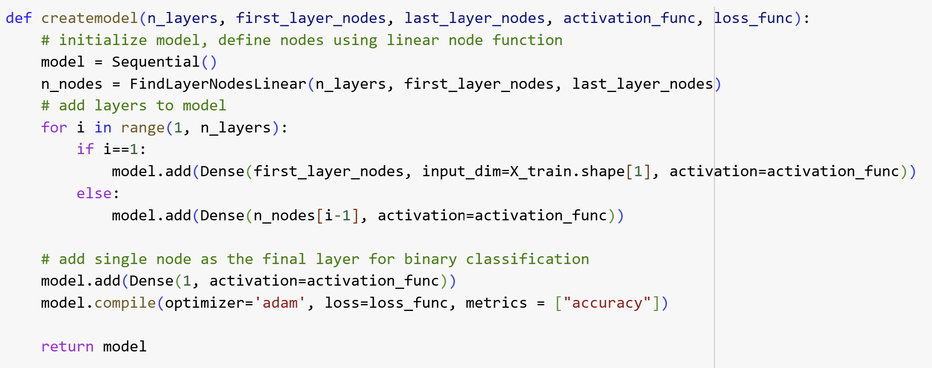
Approach: Parameter variation
Model Parameters to vary:
Number of layers = (2, 3)
Nodes in first layer = (64, 32, 16)
Epochs = (30, 60)
Activation function = (sigmoid, relu, tanh)
Loss function = (binary_crossentropy, hinge)

Slide 5
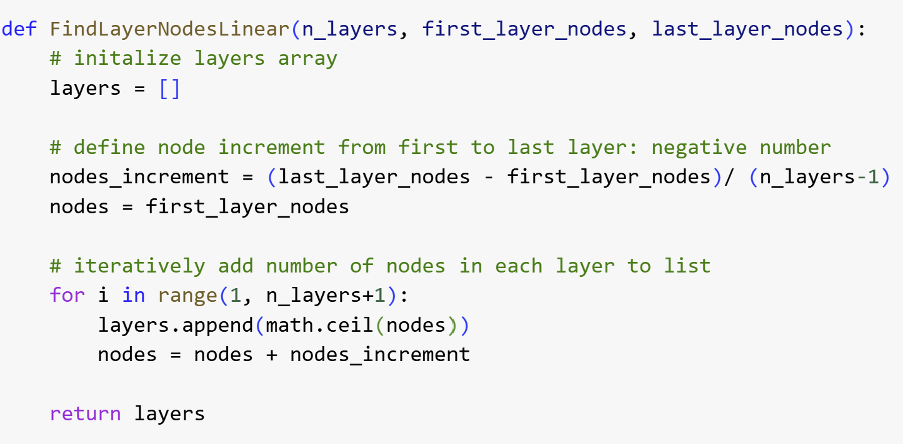
Approach: Linearly Decrease # of Nodes
Standardize number of nodes in each layer based on linear decrease
Example:
Last layer nodes = 4
First layer nodes = 64
3 nodes
Layer 1 = 64 nodes
Layer 2 = 44 nodes
Layer 3 = 24 nodes

Slide 6

Approach: Parameter tuning via GridsearchCV
GridSearchCV – initizalize hyper parameter tuning with model and grid of possible hyper parameters
Grid.fit(X,y) – trains and tests model for every possible combination of hyper parameters, returns CSV file of accuracy associated with hyperparameter combinations

Slide 7
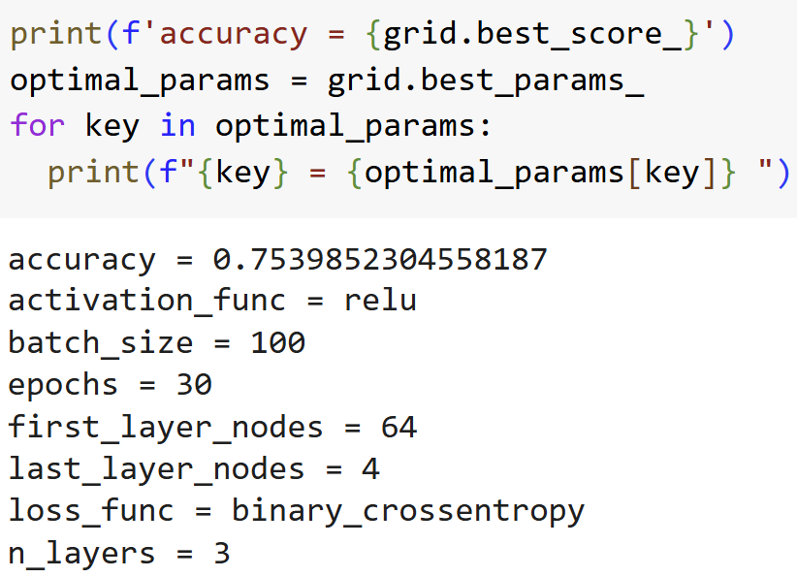
Results, Inferences and Limitations
Operations return model parameters associated with highest accuracy value
Computationally expensive
Data set used: 8 categories, 768 subjects
T4 Run time: 25 minuets
May be prone to overfitting
Model with highest accuracy may have effectively “memorized” data better than others

